Slide 1
JNCIS-ENT
Border Gateway Protocol (BGP)

Slide 2
IBGP Vs. EBGP
5
Interior and Exterior Border Gateway Protocol

Slide 3
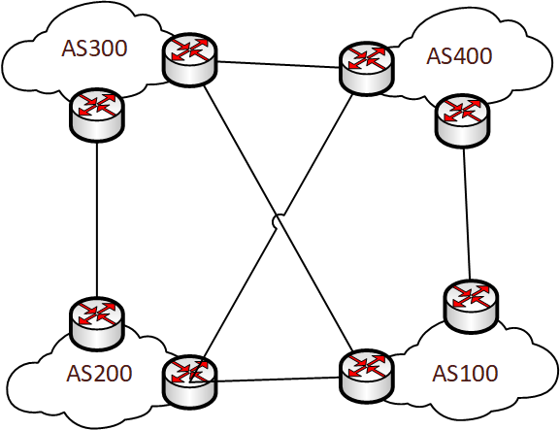
What’s the Difference?
The only configuration difference between IBGP and EBGP is the peer-as configured
When the peer-as is the same as the local router’s AS, then the peering is an IBGP peering
When the peer-as is different than the local router’s AS, then it is an EBGP peering
IBGP and EBGP have different loop avoidance rules
IBGP and EBGP have different peering connection rules

Slide 4
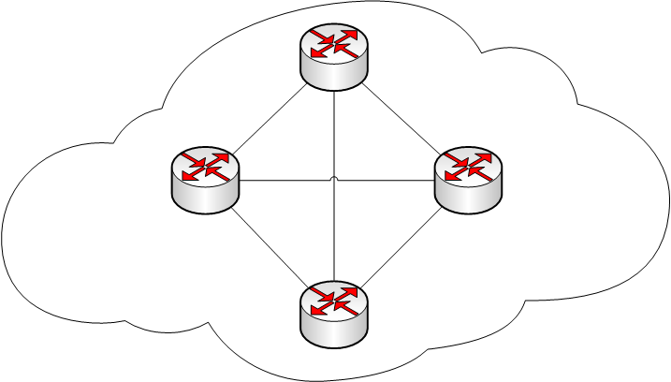
IBGP Split Horizon
IBGP’s loop avoidance mechanism is called ‘split horizon’
A route learned from an IBGP peer cannot be re-advertised to another IBGP peer
This creates a full-mesh requirement of BGP peering sessions to ensure complete reachability

Slide 5
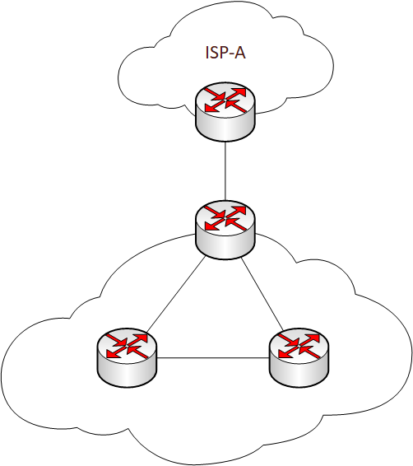
IBGP Route Advertisement
When a router advertises a route to an IBGP peer, the next-hop attribute is not changed
This can cause issues when a route learned from a EBGP peer is re-advertised to an IBGP peer
IBGP peerings should be made to loopback interfaces
Loopback connectivity is needed, typically resulting in the need for another IGP

Slide 6
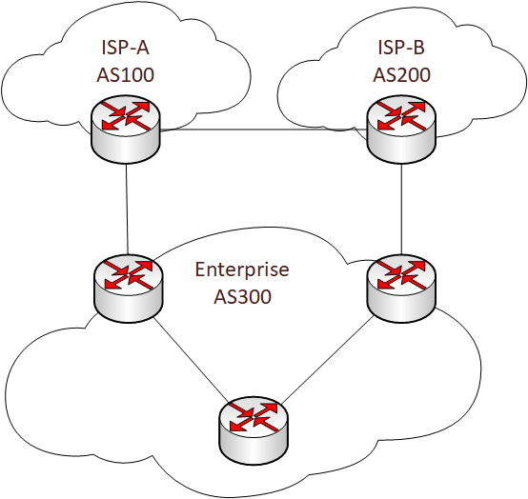
EBGP Loop Avoidance
When a router receives a route advertisement from an EBGP peer the AS Path attribute will be inspected
If the local routers’ ASN is contained in the AS Path attribute, the route will be dropped
This prevents routing loops
EBGP peering sessions should be made to interface addresses
EBGP TCP packet has a TTL of 1, causing the packet to be dropped if the peer is more than 1 hop away
Multihop may be configured to bypass this restriction

